Slide 1
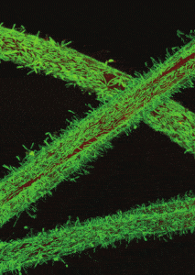
Paper Review
A detailed genome scale metabolic model of Clostridium Thermocellum investigates sources of pyrophosphate for driving glycolysis

Slide 2
Goals
Glycolysis in thermocellum is the primary pathway for the catabolism of cellodextrin and synthesis of ethanol, acetate and other desirable products.
Improve the former GEM iCBI655 model for better consistency and MEMOTE score in order to allow new hypothesis on the source of PPi powering the glycolysis of Clostridium thermocellum.

Slide 3
Methods used for model curation
The development of the new model iCTH669 is based on the previous iCBI655 and iAT601 with improvements to enhance the consistency score.
Corrections of imbalances (especially macromolecules)
Correction of erroneous molecular weights. They were primary culprits for problematic biomass yield.
Revising transport cofactors (reduction of annotated symports and antiports)

Slide 4
Methods used for tests
For each strain they ran a tracking of the fba, fva, ppi tracking in the pFBA, and yield tracking in the pFBA
Maximum and minimum global PPi production solving an optimization problem, and calculating ethanol and acetate production with those configurations.
Evaluate previously proposed PPi production cycle.
Find the deletions to create non viable thermocellum due to inability to produce Ppi. pFBA is run for the AVMO61 strain.
Metabolic analysis to find enzymes responsible for PPi production.

Slide 5
Results
Consistency was improved from 55.8% to 99.7% compared to former models. Memote score went from 72% to 94%
Better biomass yield
Categorization of PPi-producing reactions
Previously investigated PPi generating cycles expression profiles were inconsistent.
Five newly identified cycles, and NTPP-catalysed reactions and stringent response related cycle.
5 ranked deletions of genes for PPi production

Slide 6
Codes:
All codes are available at https://github.com/maranasgroup/iCTH669

